Slide 1
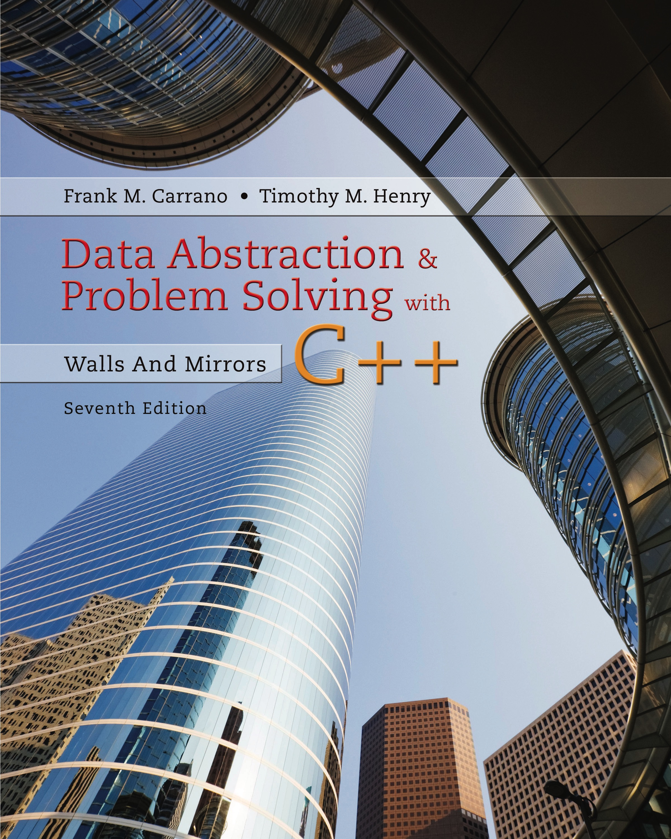
Data Abstraction & Problem Solving with C++: Walls and Mirrors
Seventh Edition
Chapter 20
Graphs
Copyright © 2017, 2013, 2007 Pearson Education, Inc. All Rights Reserved
Notes:
If this PowerPoint presentation contains mathematical equations, you may need to check that your computer has the following installed:
1) MathType Plugin
2) Math Player (free versions available)
3) NVDA Reader (free versions available)

Slide 2
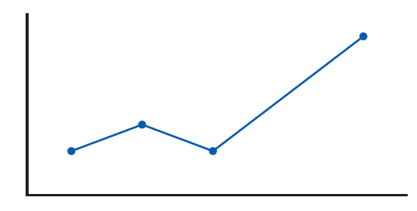
Terminology (1 of 7)
In the context of this book, graphs represent relations among data items
A graph is a set of vertices (nodes) and
A set of edges that connect the vertices
Figure 20-1 An ordinary line graph

Slide 3
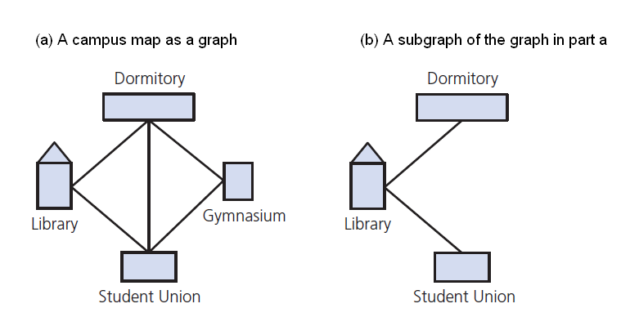
Terminology (2 of 7)
Figure 20-2 A graph and one of its subgraphs

Slide 4
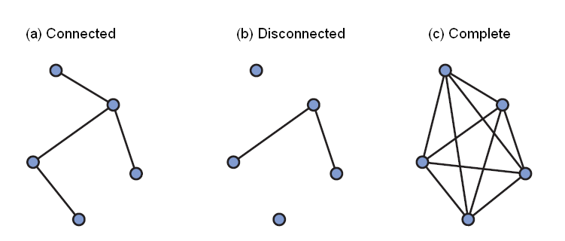
Terminology (3 of 7)
Figure 20-3 Examples of graphs that are either connected, disconnected, or complete

Slide 5
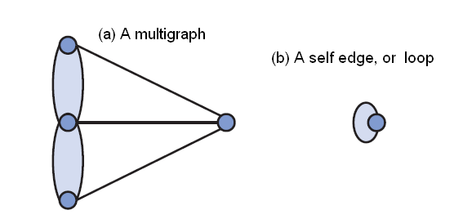
Terminology (4 of 7)
Figure 20-4 Graph-like structures that are not graphs

Slide 6
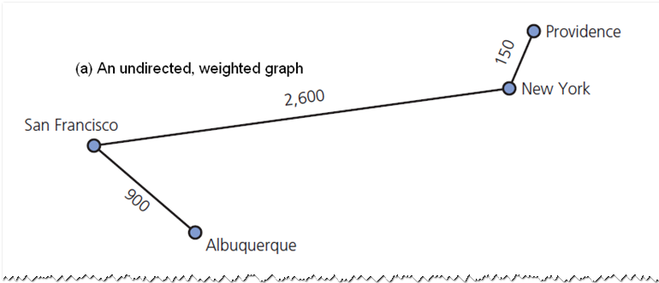
Terminology (5 of 7)
Figure 20-5 Examples of two kinds of graphs

Slide 7
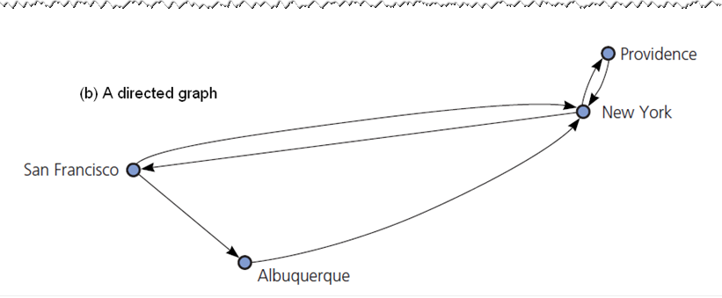
Terminology (6 of 7)
Figure 20-5 [Continued]

Slide 8
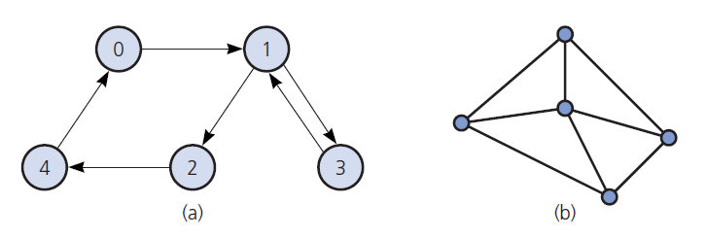
Terminology (7 of 7)
Figure 20-6 Graphs for Checkpoint Questions 1, 3, 4, 5

Slide 9
Graphs as A D Ts (1 of 4)
A D T graph operations
Test if empty
Get number of vertices, edges in a graph
See if edge exists between two given vertices
Add vertex to graph whose vertices have distinct, different values from new vertex
Add/remove edge between two given vertices
Remove vertex, edges to other vertices
Retrieve vertex that contains given value

Slide 10
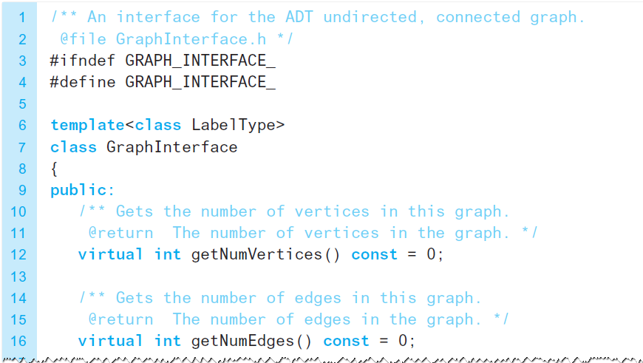
Graphs as A D Ts (2 of 4)
Listing 20-1 A C++ interface for undirected, connected graphs

Slide 11
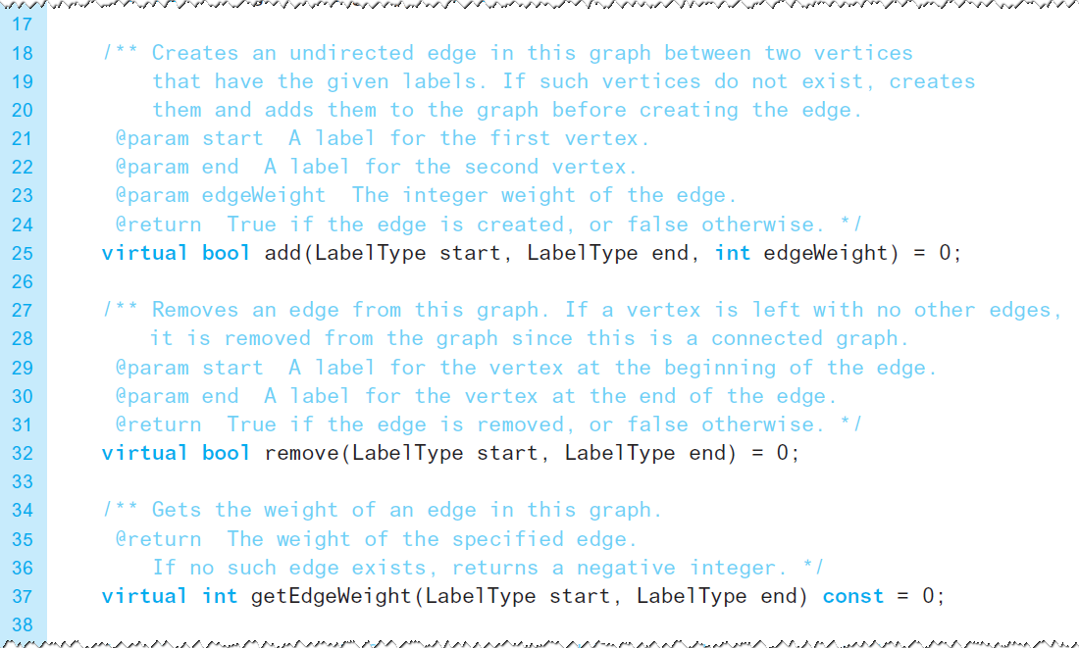
Graphs as A D Ts (3 of 4)
Listing 20-1 [Continued]

Slide 12
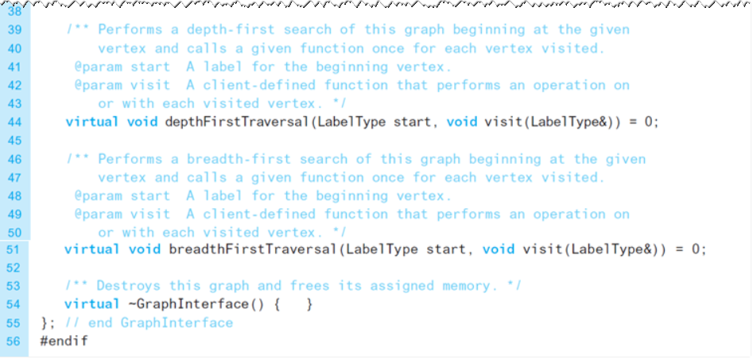
Graphs as A D Ts (4 of 4)
Listing 20-1 [Continued]

Slide 13
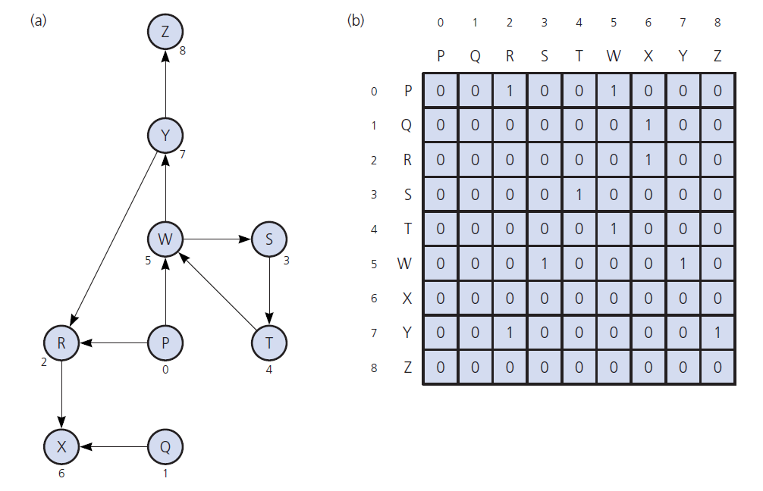
Implementing Graphs (1 of 5)
Figure 20-7 (a) A directed graph and (b) its adjacency matrix

Slide 14
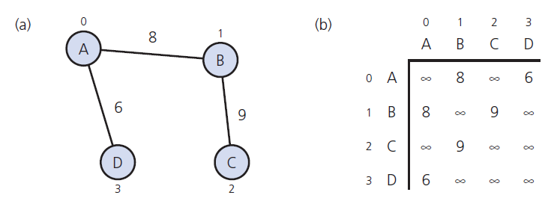
Implementing Graphs (2 of 5)
Figure 20-8 (a) A weighted undirected graph and (b) its adjacency matrix

Slide 15
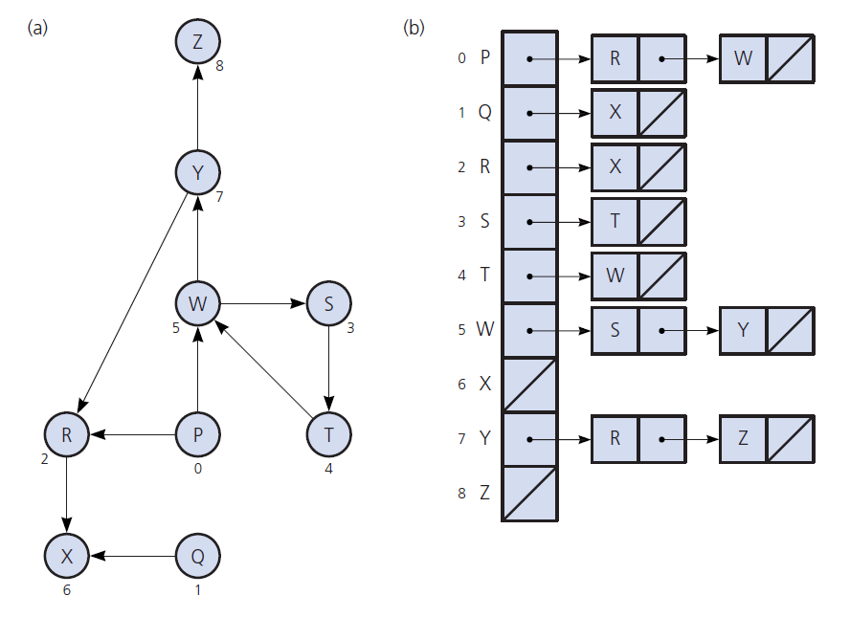
Implementing Graphs (3 of 5)
Figure 20-9 (a) A directed graph and (b) its adjacency list

Slide 16
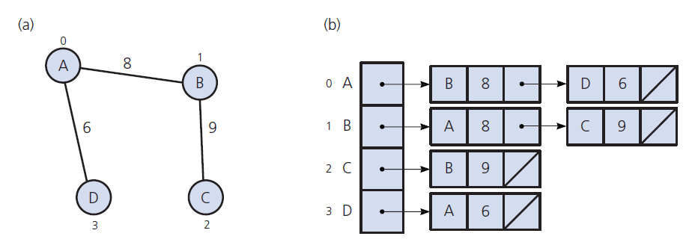
Implementing Graphs (4 of 5)
Figure 20-10 (a) A weighted undirected graph and (b) its adjacency list

Slide 17
Implementing Graphs (5 of 5)
Adjacency list
Often requires less space than adjacency matrix
Supports finding vertices adjacent to given vertex
Adjacency matrix
Supports process of seeing if there exists an edge from vertex i to vertex j

Slide 18
Graph Traversals
Visits all vertices it can reach
Visits all vertices if and only if the graph is connected
Connected component
Subset of vertices visited during a traversal that begins at a given vertex

Slide 19
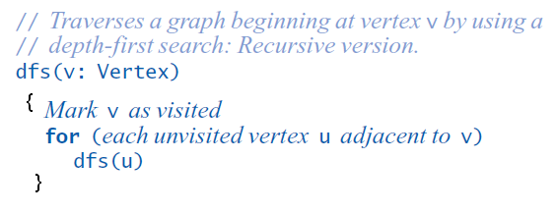
Depth-First Search (1 of 2)
D F S traversal
Goes as far as possible from a vertex before backing up
Recursive transversal algorithm

Slide 20
Breadth-First Search (1 of 3)
B F S traversal
Visits all vertices adjacent to a vertex before going forward
B F S is a first visited, first explored strategy
Contrast D F S as last visited, first explored

Slide 21
Breadth-First Search (2 of 3)
Figure 20-13 The results of a depth-first traversal, beginning at vertex a, of the graph in Figure 20-12 (see slide 24)
Node visited | Stack (top to bottom)
a | a
b | a b
c | a b c
d | a b c d
g | a b c d g
e | a b c d g e
(backtrack) | a b c d g
f | a b c d g f
(backtrack) | a b c d g
(backtrack) | a b c d
h | a b c d h
(backtrack) | a b c d
(backtrack) | a b c
(backtrack) | a b
(backtrack) | a
i | a i
(backtrack) | a
(backtrack) | (empty)

Slide 22
Breadth-First Search (3 of 3)
Figure 20-14 The results of a breadth-first traversal, beginning at vertex a, of the graph in Figure 20-12 (see slide 24)
Node visited | Stack (top to bottom)
a | a
blank | (empty)
b | b
f | b f
i | b f i
blank | f i
c | f i c
e | f i c e
blank | i c e
g | i c e g
blank | c e g
blank | e g
d | e g d
blank | g d
blank | d
blank | (empty)
h | h
blank | (empty)

Slide 23
Applications of Graphs
Topological Sorting
Spanning Trees
Minimum Spanning Trees
Shortest Paths
Circuits
Some Difficult Problems

Slide 24
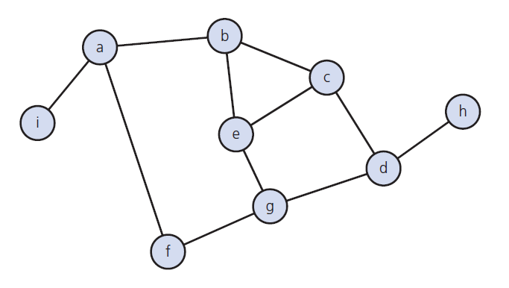
Depth-First Search (2 of 2)
Figure 20-12 A connected graph with cycles

Slide 25
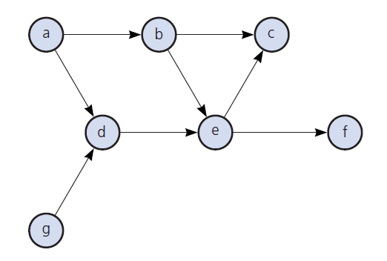
Topological Sorting (1 of 5)
Figure 20-15 A directed graph without cycles

Slide 26
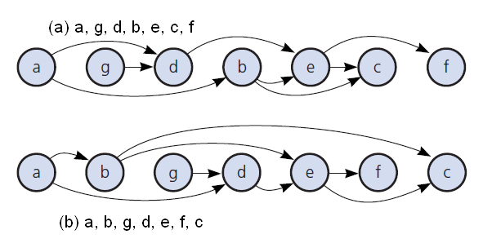
Topological Sorting (2 of 5)
Figure 20-16 The graph in Figure 20-15 arranged according to two topological orders

Slide 27
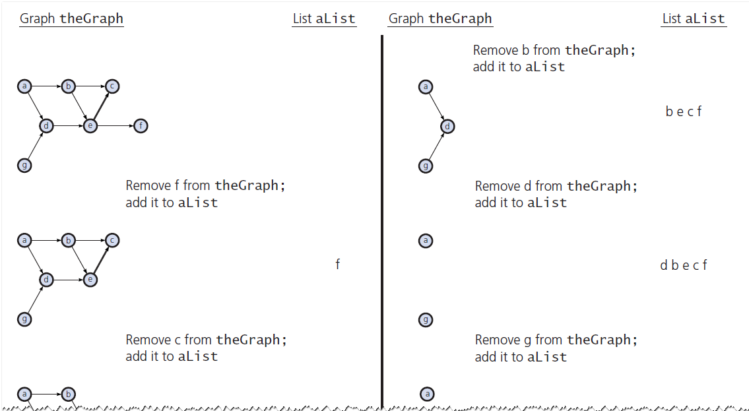
Topological Sorting (3 of 5)
Figure 20-17 A trace of topSort1 for the graph in Figure 20-15 (see slide 25)

Slide 28
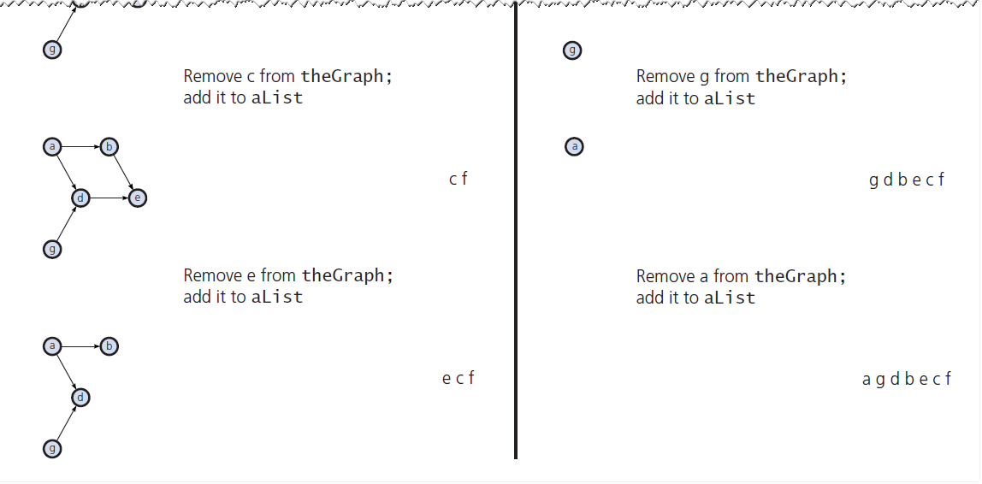
Topological Sorting (4 of 5)
Figure 20-17 [Continued]

Slide 29
Topological Sorting (5 of 5)
Figure 20-18 A trace of topSort2 for the graph in Figure 20-15 (see slide 25)
Action | Stack s (top to bottom) | List aList (beginning to end)
Push a | a | Blank
Push g | a g | Blank
Push d | a g d | Blank
Push e | a g d e | c
Push c | a g d e c | c
Pop c, add c to aList | a g d e | f c
Push f | a g d e f | e f c
Pop f, add f to aList | a g d e | d e f c
Pop e, add e to aList | a g d | g d e f c
Pop d, add d to aList | a g | g d e f c
Pop g, add g to aList | a | b g d e f c
Push b | a b | a b g d e f c
Pop b, add b to aList | a | Blank
Pop a, add a to aList | (empty) | Blank

Slide 30
Spanning Trees (1 of 5)
A tree is an undirected connected graph without cycles
Detecting a cycle in an undirected graph
Connected undirected graph with n vertices must have at least n – 1 edges
If it has exactly n – 1 edges, it cannot contain a cycle
With more than n – 1 edges, must contain at least one cycle

Slide 31
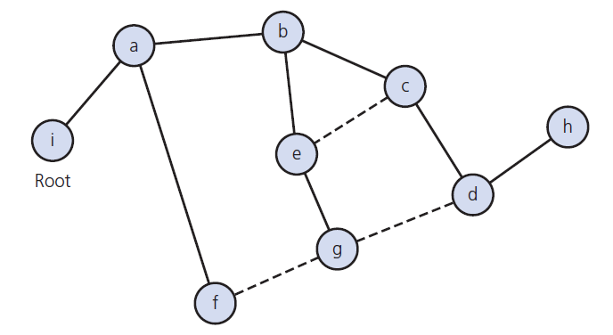
Spanning Trees (2 of 5)
Figure 20-19 A spanning tree for the graph in Figure 20-12 (see slide 24)

Slide 32
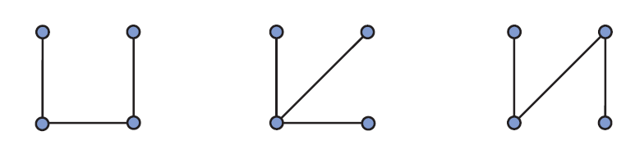
Spanning Trees (3 of 5)
Figure 20-20 Connected graphs that each have four vertices and three edges

Slide 33
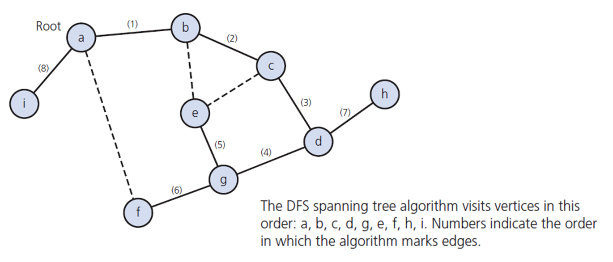
Spanning Trees (4 of 5)
Figure 20-21 Connected graphs that each have four vertices and three edges

Slide 34
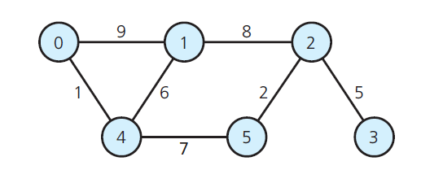
???????????
Figure 20-22 A graph for Checkpoint Questions 8, 9, and 10 and for Exercises 1 and 4

Slide 35
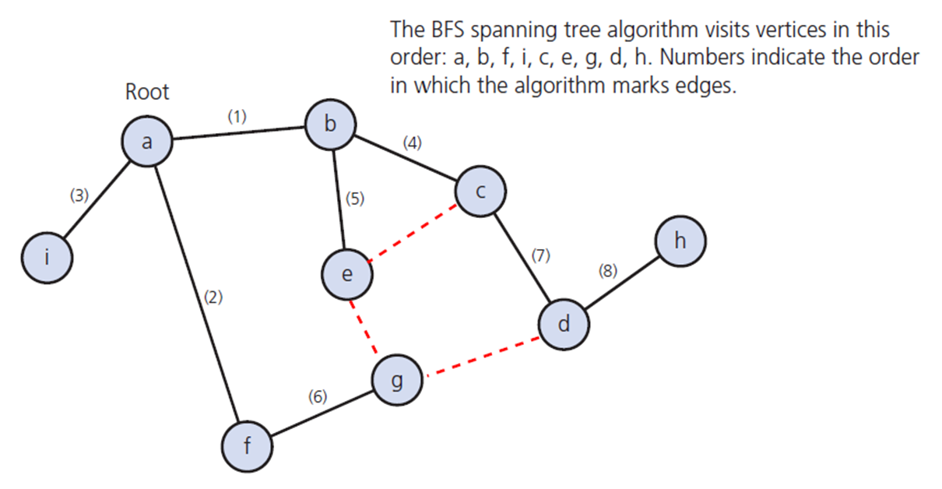
Spanning Trees (5 of 5)
Figure 20-23 The B F S spanning tree rooted at vertex a for the graph in Figure 20-12 (see slide 24)

Slide 36
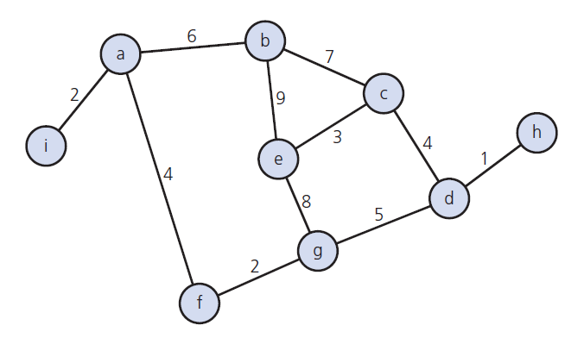
Minimum Spanning Trees (1 of 4)
Figure 20-24 A weighted, connected, undirected graph

Slide 37
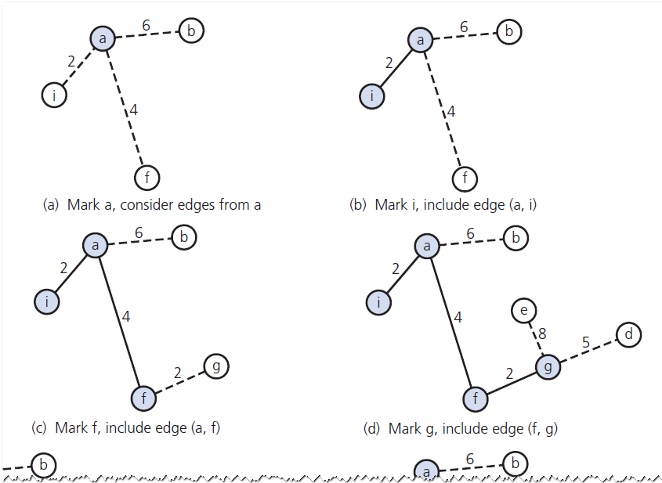
Minimum Spanning Trees (2 of 4)
Figure 20-25 A trace of primsAlgorithm for the graph in Figure 20-23, beginning at vertex a (see slide 35)

Slide 38
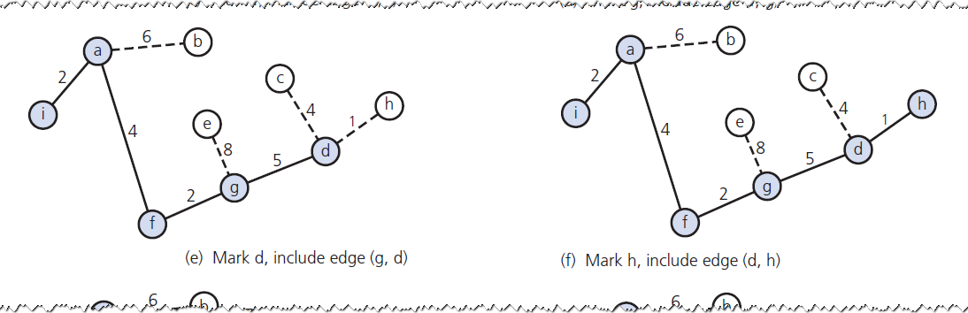
Minimum Spanning Trees (3 of 4)
Figure 20-25 [Continued]

Slide 39
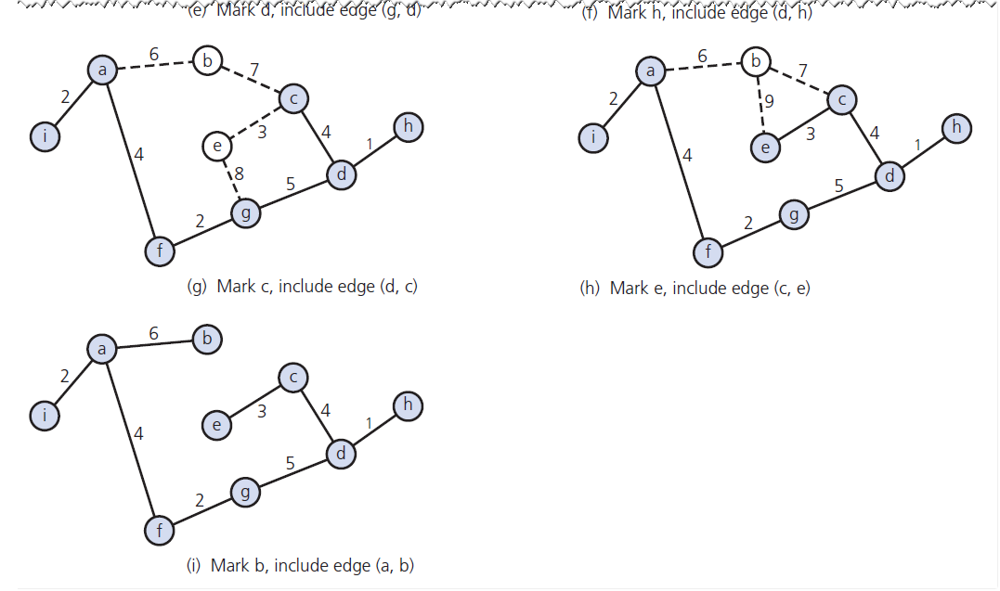
Minimum Spanning Trees (4 of 4)
Figure 20-25 [Continued]

Slide 40
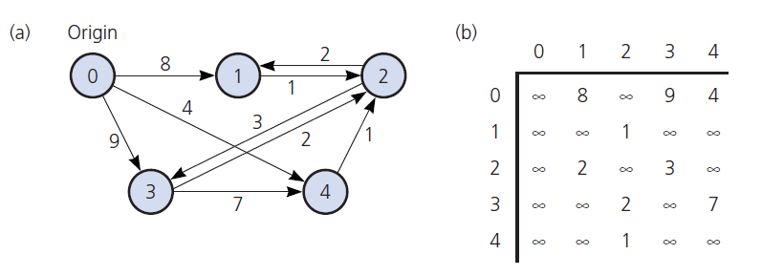
Shortest Paths (1 of 4)
The shortest path between two vertices in a weighted graph
Has the smallest edge-weight sum
Figure 20-26 (a) A weighted directed graph and (b) its adjacency matrix

Slide 41
Shortest Paths (2 of 4)
Figure 20-27 A trace of the shortest-path algorithm applied to the graph in Figure 20-25a (see slide 37)
Step | v | vertexSet | Weight [0] | Weight [1] | Weight [2] | Weight [3] | Weight [4]
1 | - | 0, | 0 | 8 | Infinity | 9 | 4
2 | 4 | 0, 4 | 0 | 8 | 5 | 9 | 4
3 | 2 | 0, 4, 2 | 0 | 7 | 5 | 8 | 4
4 | 1 | 0, 4, 2, 1 | 0 | 7 | 5 | 8 | 4
5 | 3 | 0, 4, 2,1, 3 | 0 | 7 | 5 | 8 | 4

Slide 42
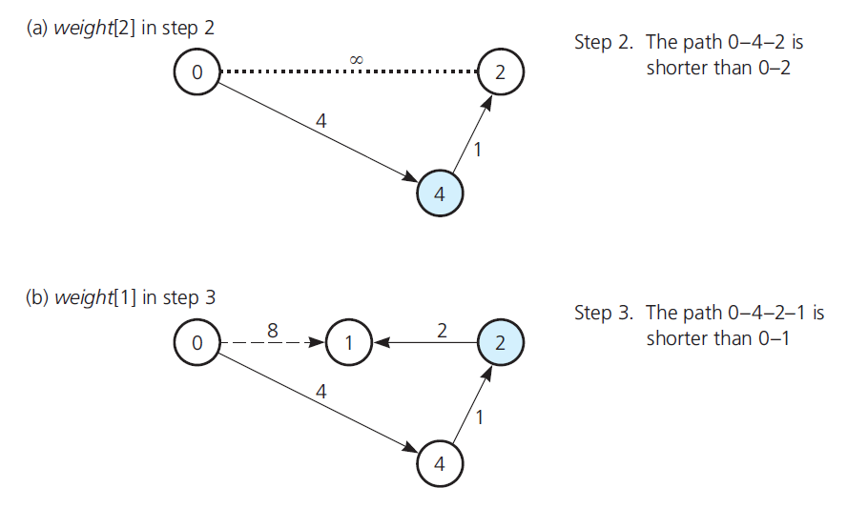
Shortest Paths (3 of 4)
Figure 20-28 Checking weight[u] by examining the graph: (a) weight[2] in step 2; (b) weight[1] in step 3;

Slide 43
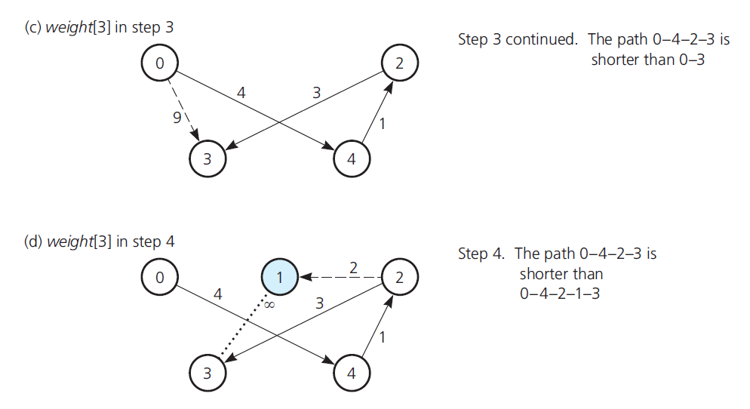
Shortest Paths (4 of 4)
Figure 20-28 Checking weight[u] by examining the graph: (c) weight[3] in step 3; (d) weight[3] in step 4

Slide 44
Circuits (1 of 7)
Circuit
Another name for type of cycle common in statement of certain types of problems
Typical circuits either visit every vertex once or every edge once
Euler Circuit
Begins at vertex v
Passes through every edge exactly once
Terminates at v

Slide 45
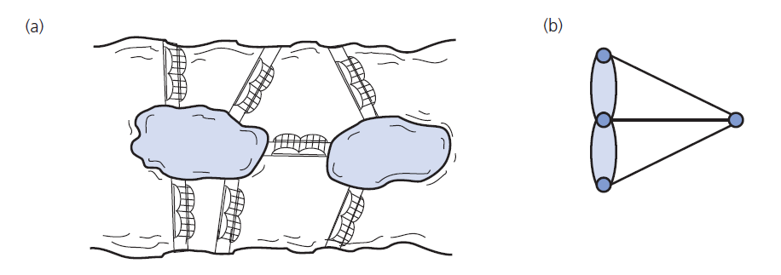
Circuits (2 of 7)
Figure 20-28 (a) Euler’s bridge problem and (b) its multigraph representation

Slide 46
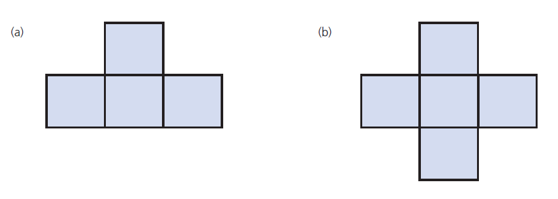
Circuits (3 of 7)
Figure 20-29 Pencil and paper drawings

Slide 47
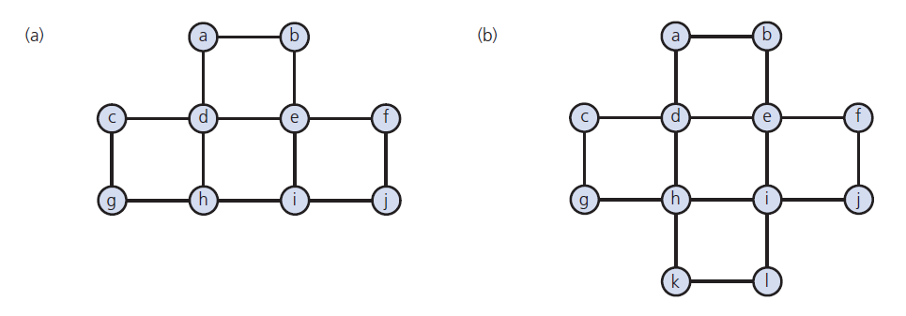
Circuits (4 of 7)
Figure 20-30 Connected undirected graphs based on the drawings in Figure 20-29

Slide 48
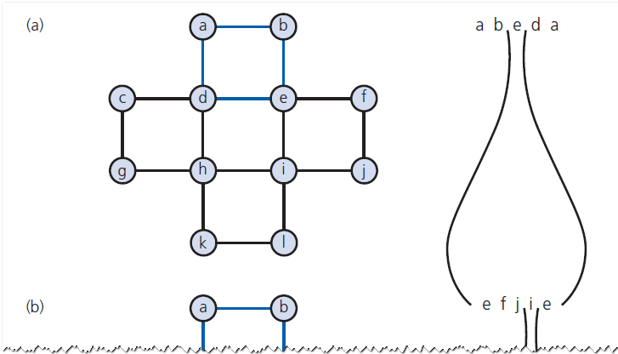
Circuits (5 of 7)
Figure 20-31 The steps to find an Euler circuit for the graph in Figure 20-30b

Slide 49
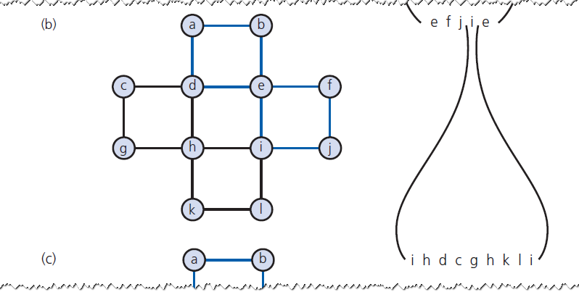
Circuits (6 of 7)
Figure 20-31 [Continued]

Slide 50
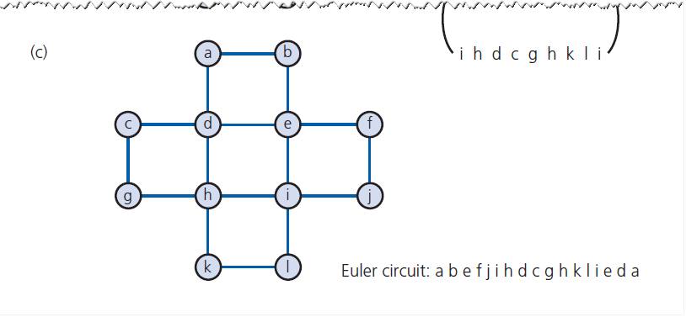
Circuits (7 of 7)
Figure 20-31 [Continued]

Slide 51
Some Difficult Problems (1 of 2)
Hamilton circuit
Begins at vertex v
Passes through every vertex exactly once
Terminates at v
Variation is “traveling salesperson problem”
Visit every city on his route exactly once
Edge (road) has associated cost (mileage)
Goal is determine least expensive circuit

Slide 52
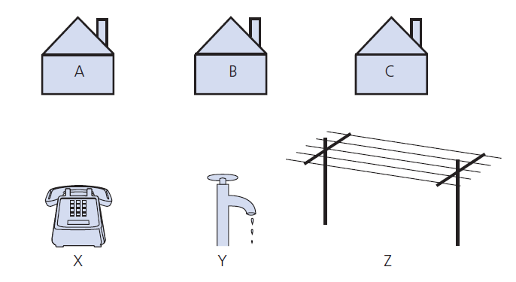
Some Difficult Problems (2 of 2)
Figure 20-32 The three utilities problem

Slide 53

Copyright

